Slide 1




Slide 2

ENSE 281 GROUP PROJECT
Project Description: Design & Develop A Small To Medium Scaled, Web-Based Software Application
WINTER 2026 - GROUP E
- Ali Abdullah
- Nyabijek Gatdet
- Chiemego Emmanuel
- Chinedu Godswill

Slide 3


Slide 4

PROJECT IDEA / BACKGROUND
People try to find different services during different seasons, for some occasions, or throughout the year as well.
Services include snow removal, leaves raking, fence painting, and many more, but they are not always budget friendly or reachable quickly.
Different ideas to enter this market with a number of different questions making their way into the golden circle, like:
Why do we need to step into this market, but in a different way to change the game around and make an impact as well?
Who are the people that need certain services and the ones that could provide those services, and how can they meet?
What constraints we currently face, and what can we do to make sure that these services stay budget friendly, and reachable?
"Instead of you approaching them, let them approach you"

Slide 5
PROJECT IDEA / BACKGROUND
WHY: To bridge the gap between workers and basic home jobs while trying to eliminate the middle-men or big businesses that charge massive amounts.
WHO: Home-owners willing to get a gig done and students or workers skilled in basic home jobs, that can meet through a common social source.
WHAT: A simple web-based software application where customers can post gigs and workers can accept them to earn money, but time and skill constraints will exist for us.
"Instead of you approaching them, let them approach you"

Slide 6
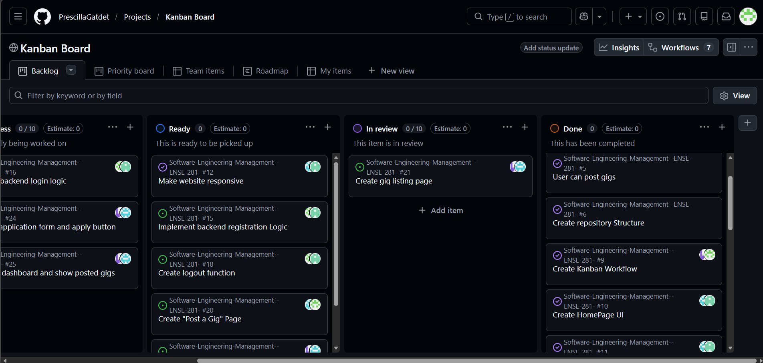
Kanban board
Backlog · Kanban Board

Slide 7

Minimum Viable Products
Dual Portal System
Customers Posting Gigs
Workers Accepting Gigs
Bargaining Feature
In-App Chat Function

Slide 8
Architecture & Design
We implemented an MVC (Model-View-Controller) architecture:
Model: Handles data in the form of databases or schemas
View: Displays the interface to users as different pages or popups
Controller: Manages logic and interactions by providing control or functionality
This individuality of each aspect of architecture allowed us to:
Maintain clean code
Improve scalability
Simplify debugging

Slide 9
Architecture & Design
Full Stack Development Logics:
Major Steps In Designing:
Design HTML pages for static view
HTML, CSS, JAVASCRIPT, DOM, NODE.JS, EJS, MONDGODB, EXPRESS, PASSPORT etc
Update CSS file throughout
Convert HTML files into EJS files
Utilize all functional logics to make each page interactive and implement databases for each model (schema)

Slide 10


Slide 11

Any Questions?
Any Suggestions?
Any Specifications?
Any Recommendations?

Slide 12




